Slide 1

COMP-SCI 55510 - Advanced Software Engineering
Project Presentation (May 7th, 2019)
Dhabbah,Khalid Mohammed A(6)
Doss,Corey Jason(8)
Sun,Chen (23)
Xie,Tian Cheng(25)

Slide 2

Model as a service
Our platform is an online platform that uses machine learning (ML) and deep learning (DL) models. The platform offers seven different models that provide users with information about uploading their own images and identifying images. Users can choose the most suitable model.

Slide 3
7 Models
DenseNet121
InceptionV3
MobileNet
Nasnet
ResNet50
VGG16
xception

Slide 4
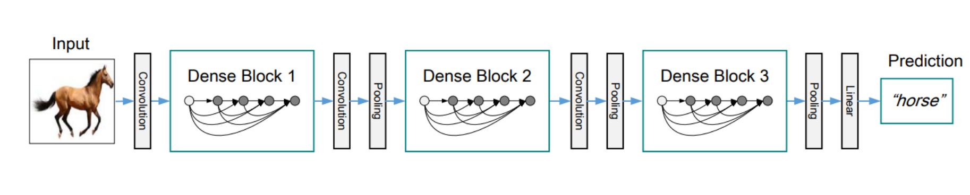
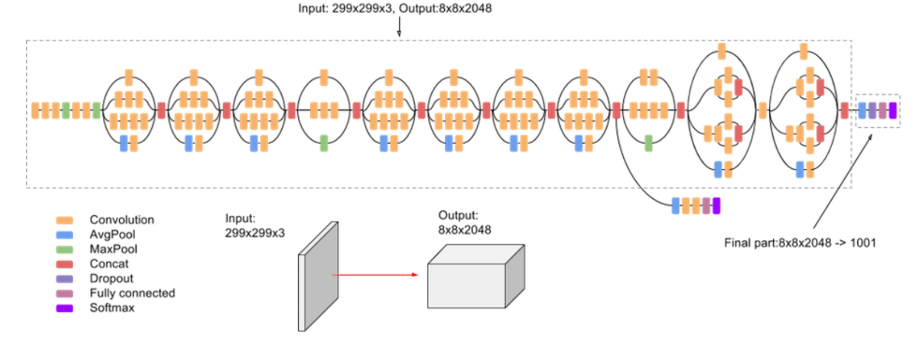
DenseNet121:It is a logical extension of ResNet.DenseNet connects the output of the previous layer instead of using summation.
InceptionV3 :Inception v3 is a widely-used image recognition model that has been shown to attain greater than 78.1% accuracy on the ImageNet dataset.

Slide 5
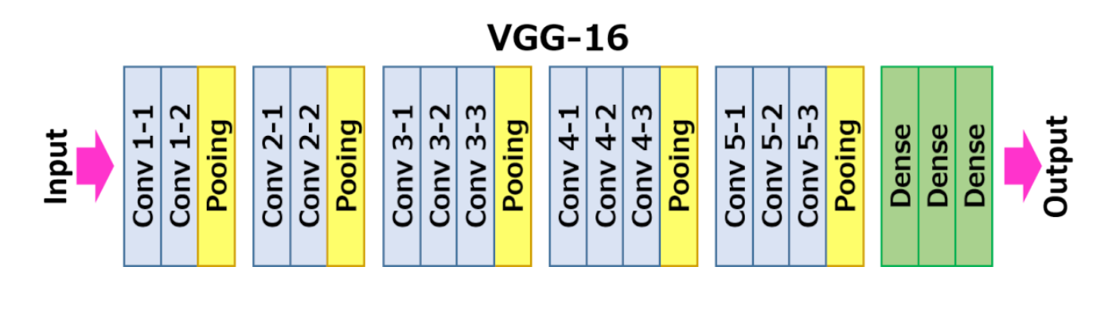
ResNet50：It is a deep convolutional networks for classification.
VGG16：It convolutional neural network is a model proposed by Oxford University in 2014.It is simple and practical, the most popular of which is VGG-16, which is a 16-layer model.

Slide 6
MobileNet:It is an efficient model for mobile and embedded devices. MobileNets is based on streamlined, using depth wise separable convolutions to build lightweight deep neural networks.
Nasnet :It classifies images. Given an image, the NasNet network will output probabilities of the different classes that an image could potentially belong to.
xception:The mapping of cross-channel correlation and spatial correlation in the feature map of the convolutional neural network can be completely decoupled. This assumption is an extreme assumption in the Inception structure.

Slide 7
Models training
Convolutional Neural Network should be involved in order to do some significant steps, which are embedding, convolution, pooling, flattening, full connection.
Also, loss and accuracy are playing a significant role. The loss is the number of errors in prediction, so it should be decreased, and the accuracy should be increased.

Slide 8
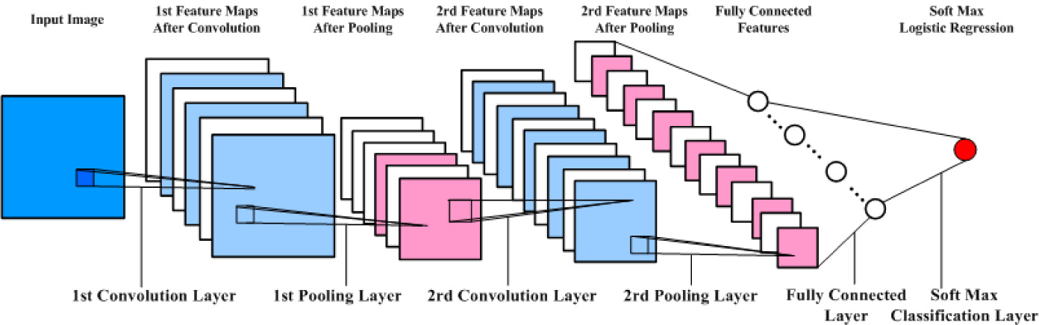
Here is how to get the output from a pre-trained CNN model we received using Jupyter Notebook.
Here is how to get the output from a pre-trained CNN model we received using Jupyter Notebook.
Here is how to get the output from a pre-trained CNN model we received using Jupyter Notebook.
Here is how to get the output from a pre-trained CNN model we received using Jupyter Notebook.
Here is how to get the output from a pre-trained CNN model we received using Jupyter Notebook.

Slide 9
Deployment
Link:
https://model-as-service-frontend.herokuapp.com/home
Video:
https://youtu.be/3_5osV7bB6k

Slide 10
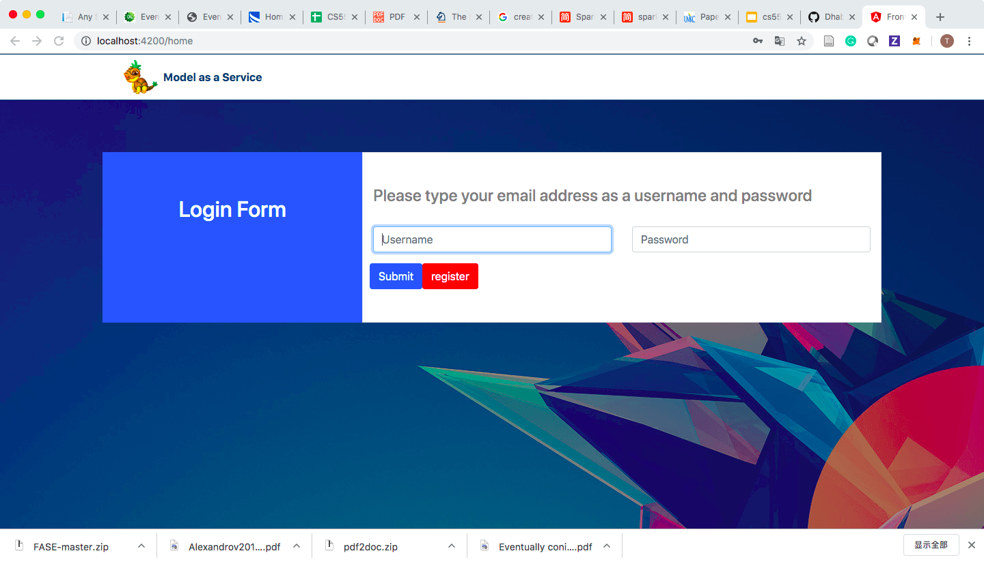
Deployment-Login

Slide 11
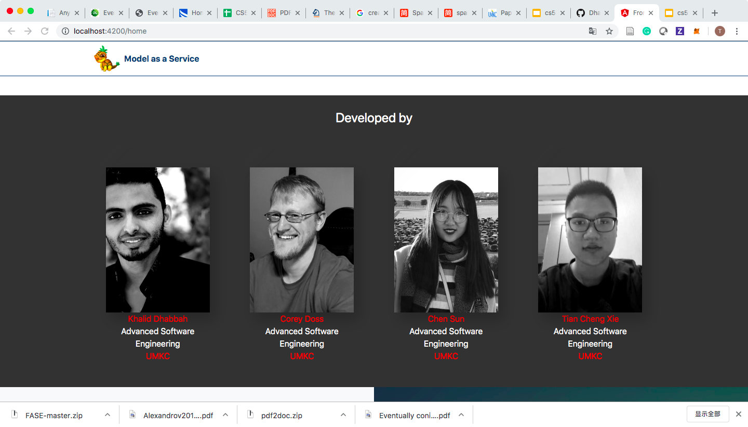
UI of Home Page

Slide 12
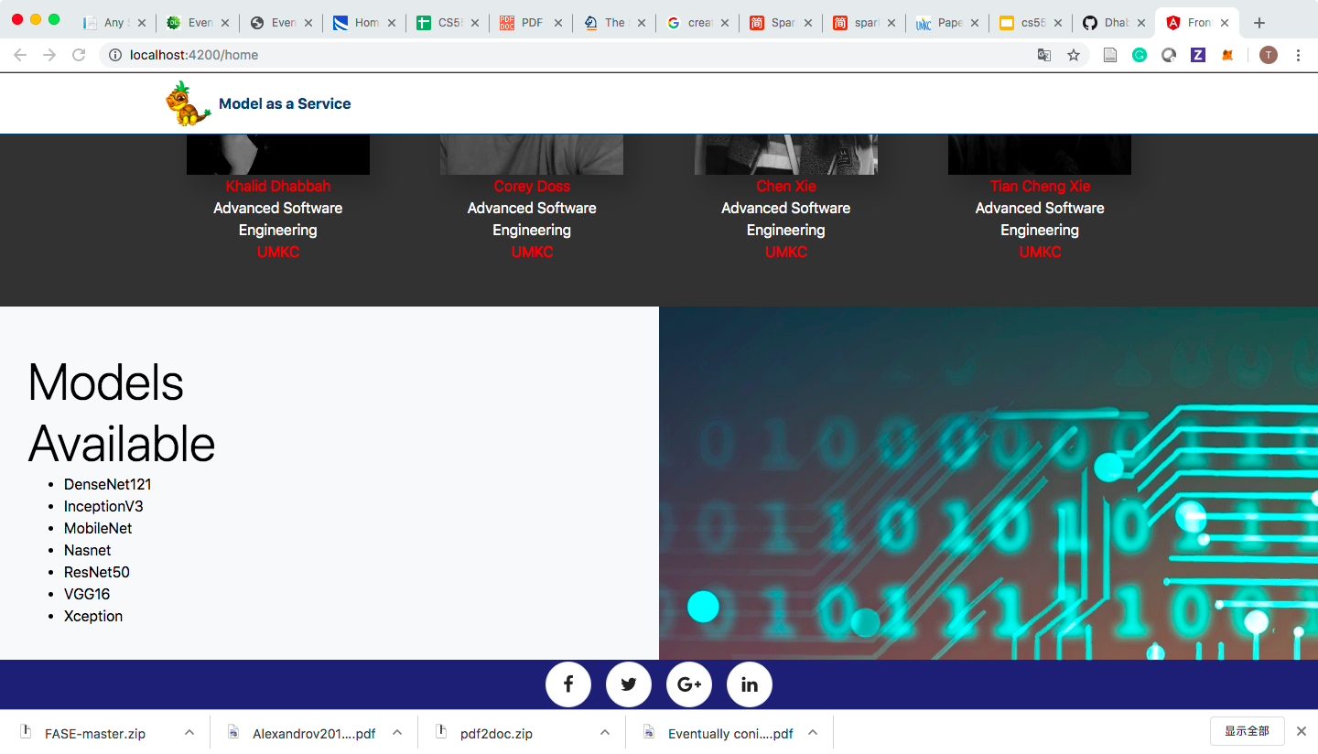
UI of Home Page

Slide 13
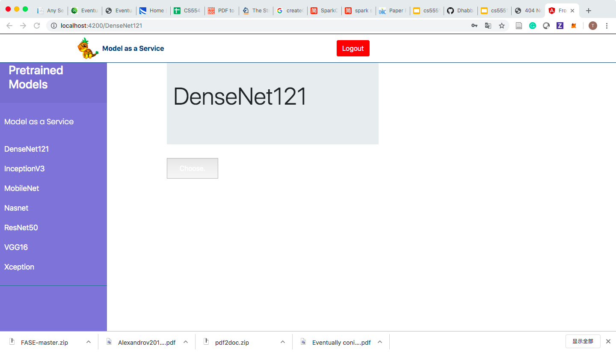
Models Page UI

Slide 14
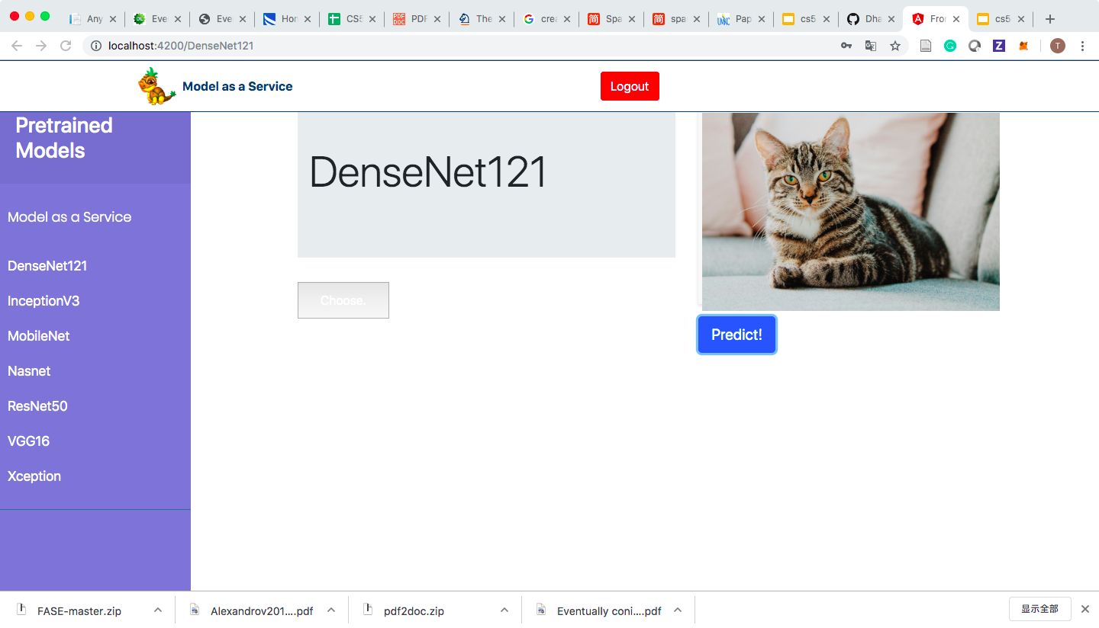
Upload the Image

Slide 15
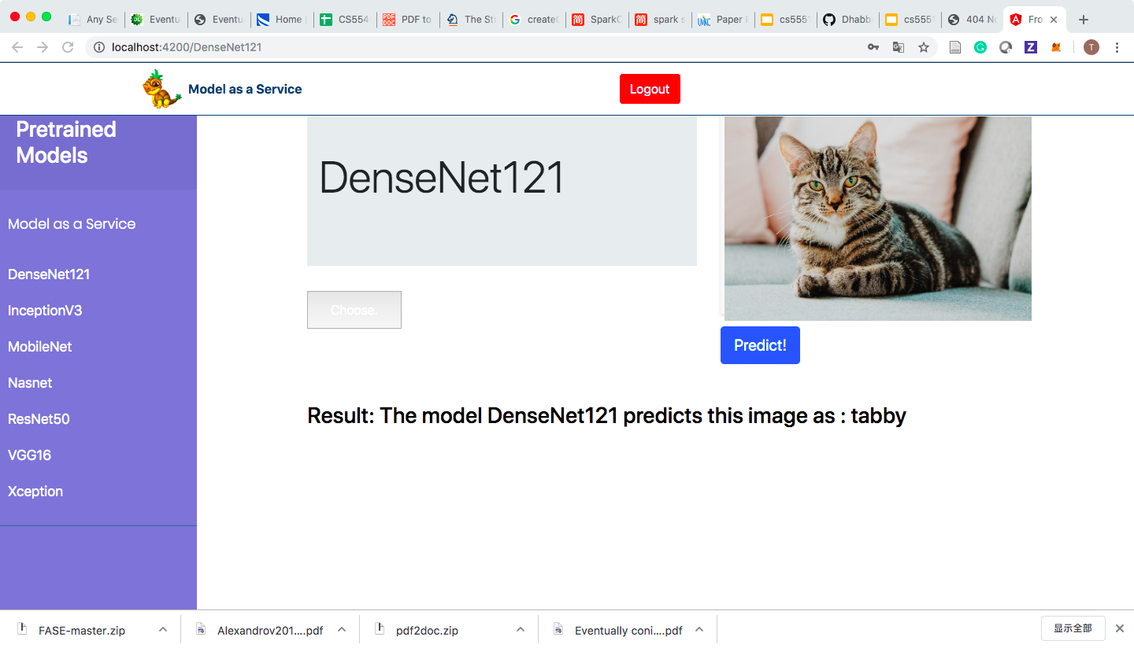
Prediction

Slide 16
Reference
https://arxiv.org/abs/1704.04861
https://www.modeldepot.io/jbrandowski/nasnet-mobile
https://neurohive.io/en/popular-networks/vgg16/
https://www.kaggle.com/lamhoangtung/densenet-121-lb-0-925
https://www.kaggle.com/pytorch/densenet121
https://www.jianshu.com/p/cc830a6ed54b
https://www.osapublishing.org/boe/fulltext.cfm?uri=boe-8-5-2732&id=363511

Slide 17

Thank you!

